Slide 1
Gyros and Filters

Slide 2
Our old friends FREE IMU
Use the ITG3200 library to setup the gyro
Run startup calibration
Get gyro data

Slide 3
Setting up the gyro
#define SAMPLE_RATE 7.0
ITG3200 gyro = ITG3200();
void gyrobegin(){
gyro.reset();
gyro.init(ITG3200_ADDR_AD0_LOW);
DEBUG_PRINT("zeroCalibrating...");
gyro.zeroCalibrate(2500,2);
DEBUG_PRINTLN("done.");
delay(100);
}
void setup(){
pinMode(LED_PIN, OUTPUT);
digitalWrite(LED_PIN, HIGH);
DEBUG_BEGIN(115200);
Wire.begin();
gyrobegin();
digitalWrite(LED_PIN, LOW);
lastMilli = millis();
}

Slide 4
Getting some readings
void getGyroValues(){
float xyz[3];
gyro.readGyro(xyz);
gx = xyz[0];
gy = xyz[1];
gz = xyz[2];
}
void loop() {
curMilli = millis();
if ((curMilli - lastMilli) > SAMPLE_RATE){
getGyroValues();
int gyroMax = absMax(gy,absMax(gx,gz));
lastMilli = curMilli;
DEBUG_PRINT(curMilli);
DEBUG_PRINT(" , ");
DEBUG_PRINT(gyroMax);
}
else if((curMilli - lastMilli) < 0){
lastMilli = curMilli;
}
}

Slide 5
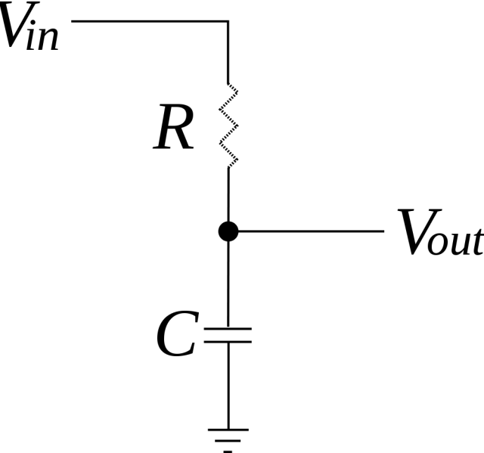
Filtering – The low pass
At low frequencies, there is plenty of time for the capacitor to charge up to practically the same voltage as the input voltage.
At high frequencies, the capacitor only has time to charge up a small amount before the input switches direction.
The output goes up and down only a small fraction of the amount the input goes up and down.
This effectively limits how “fast” we can change something

Slide 6
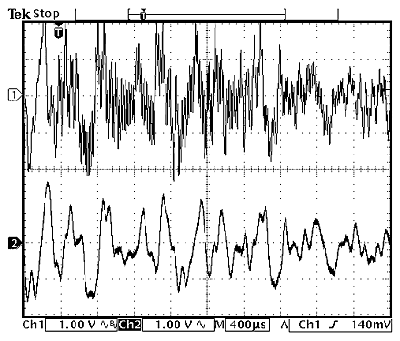
The effect

Slide 7
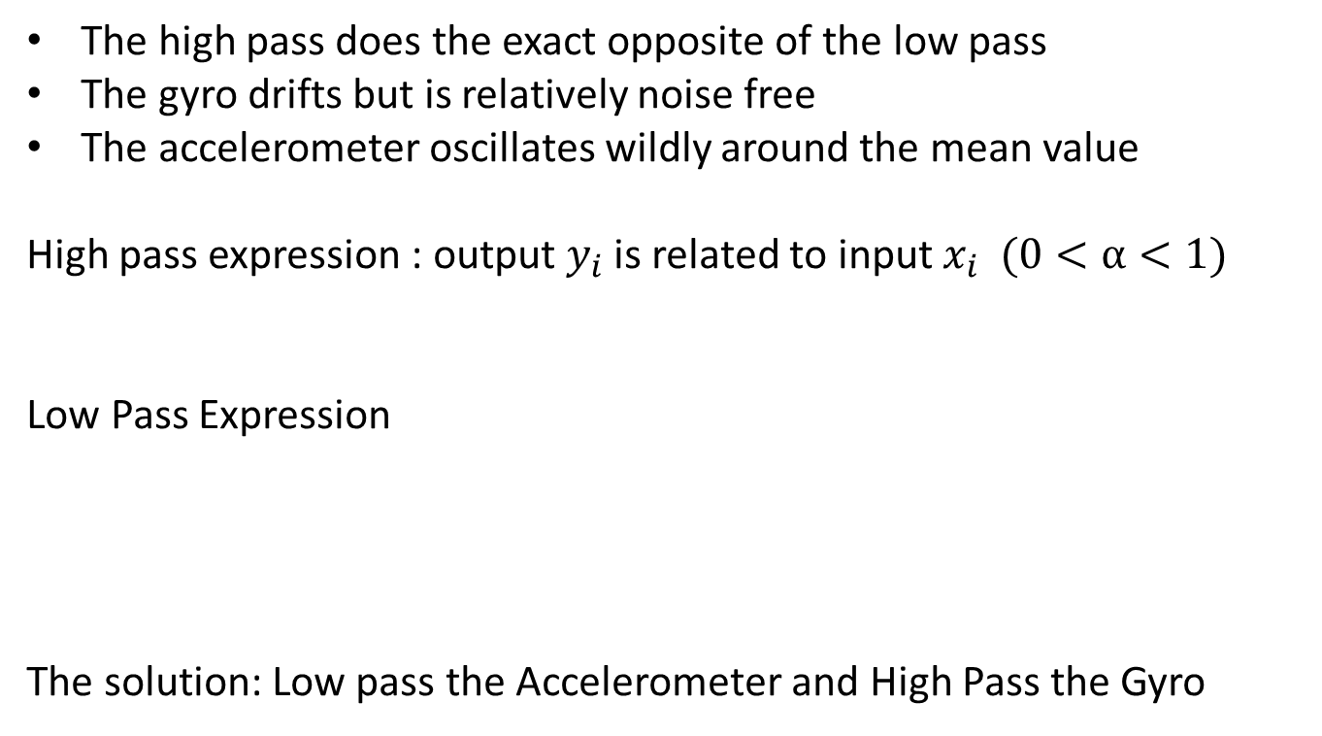
Coposite filtering
The high pass does the exact opposite of the low pass
The gyro drifts but is relatively noise free
The accelerometer oscillates wildly around the mean value
High pass expression : output $y_{i}$is related to input $x_{i} (0<α<1)$
Low Pass Expression
The solution: Low pass the Accelerometer and High Pass the Gyro

Slide 8
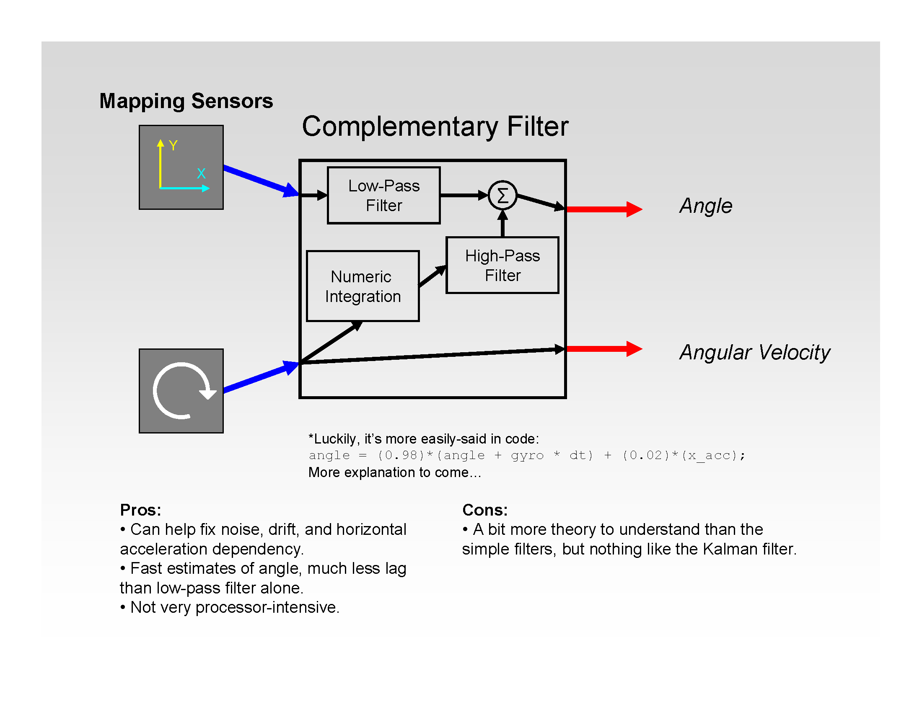

Slide 9
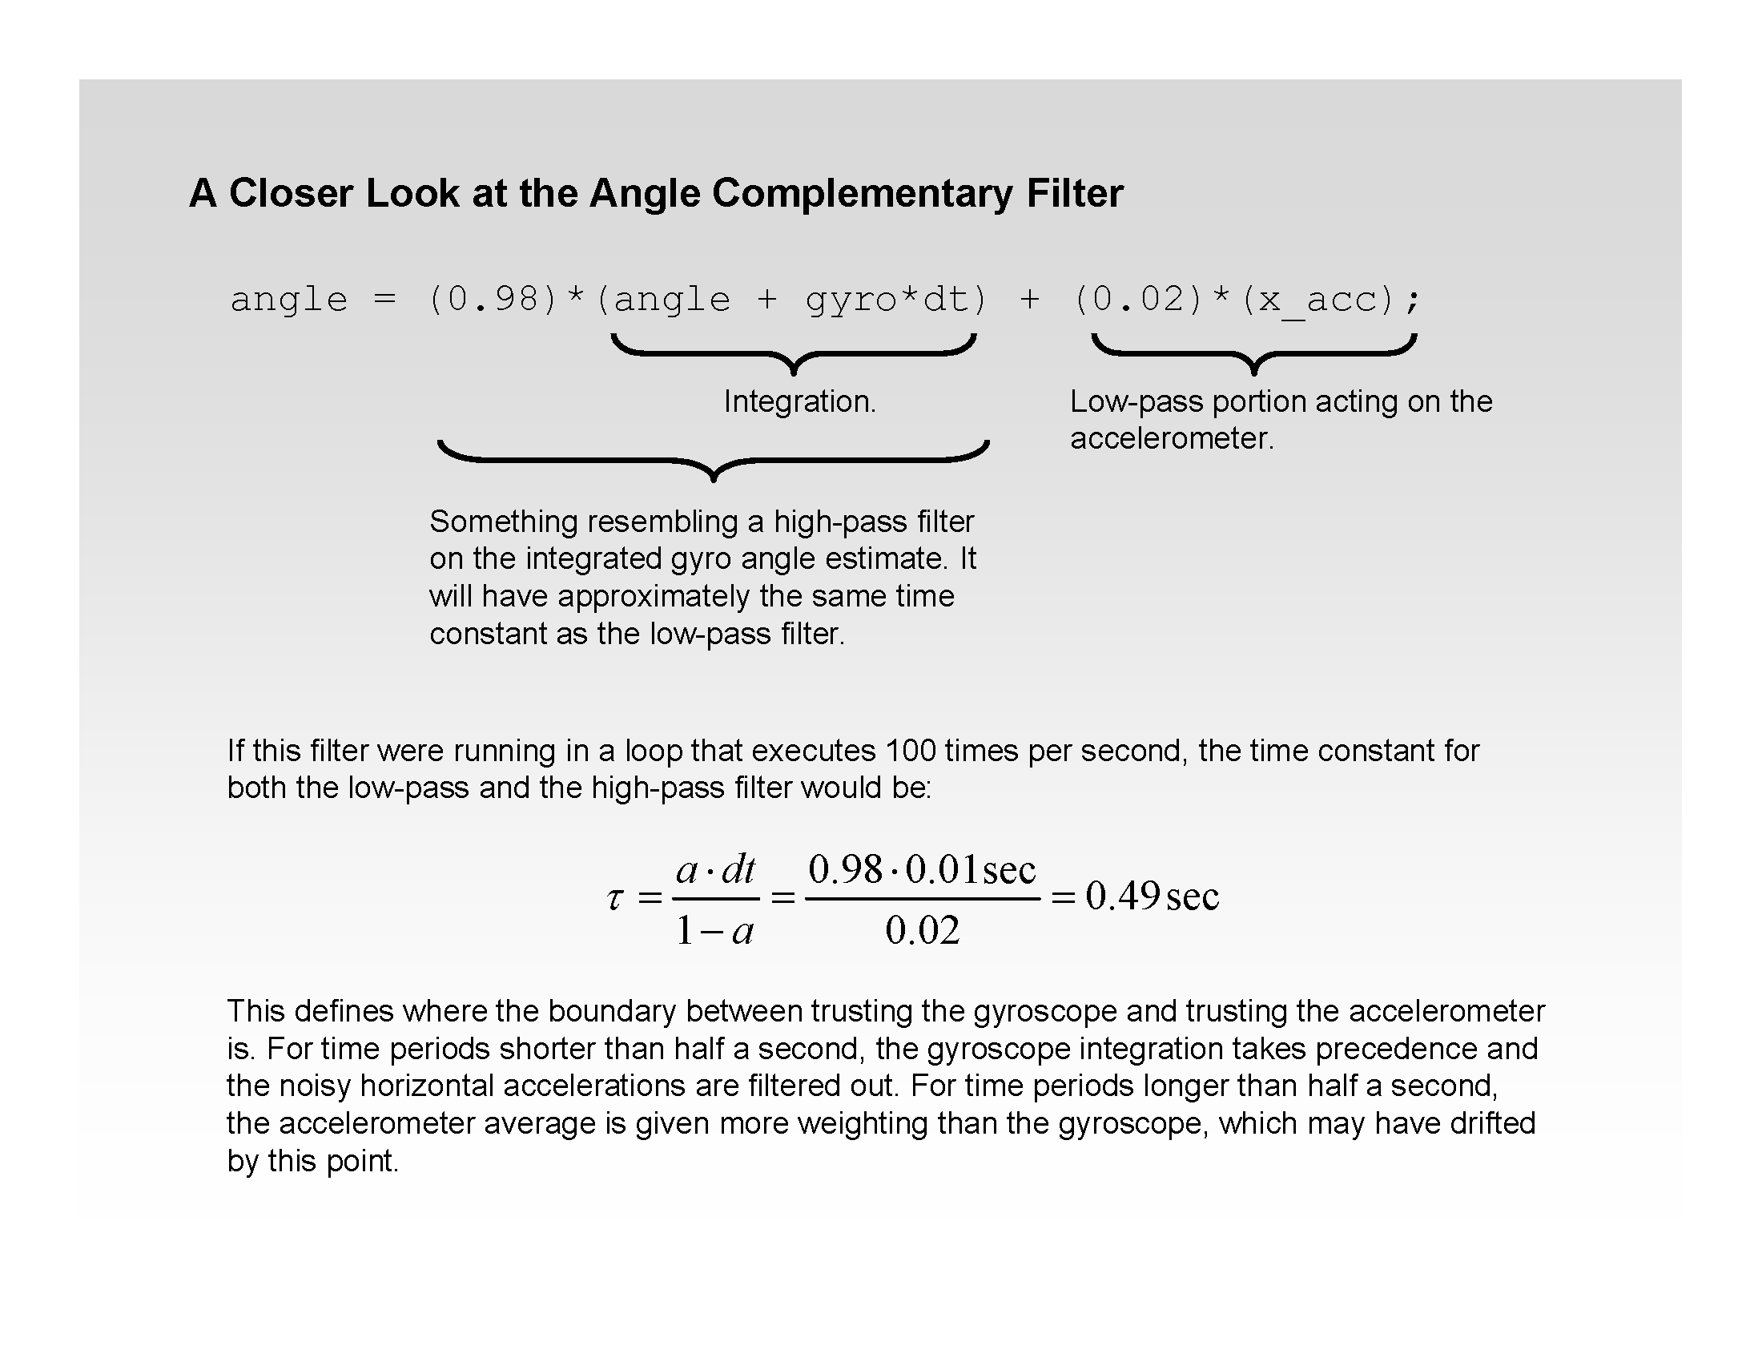

Slide 10
Composite Filtering Code
alpha = TIME_CONSTANT / (TIME_CONSTANT + SAMPLE_RATE); // calculate the scaling coefficent
float compositeFilter(float acc, float gyro, float rate, float angle){
return alpha * (angle + (gyro * rate)) + (1 - alpha) * acc; // the actual filter
}
use this in the merger of the previous code.

